Slide 1
ENGR489 Project
Modelling a Self-Organising Tree
Bryony Gatehouse
Supervised by: Zohar Levi
Notes:
- Hi
- My project was to develop a program that models a self-organising tree.

Slide 2

Trees are important
Unique
Environmental Conditions
Notes:
WHY?
Trees are important
they produce many nesscaries in our lives including food, wood, and O2
and they are an important visual detail in our environments.
Thus, graphics designers need to be able to produce realistic trees for backgrounds or animated features
However this can take a long time, even if using the same base model, as each tree needs to look unique.
I found many research papers suggesting methods for producing tree models based on algorithms and patterns.
Thus, the project was to implement one of these papers which could:
Produce a unique tree
React to environmental conditions

Slide 3
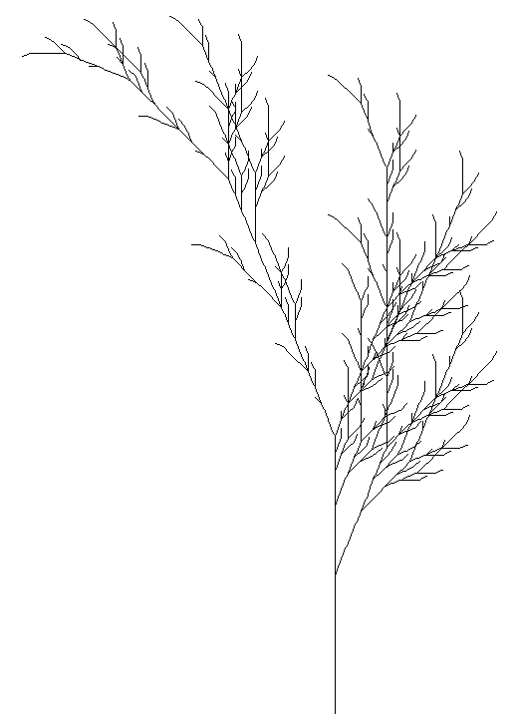
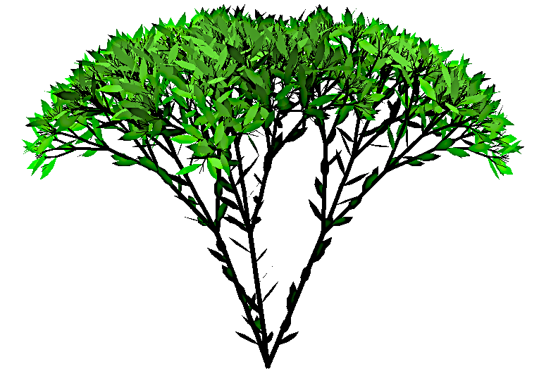
Lindenmayer System
Palubicki Tree
Rules
Pattern
Light
Empty Space
Gravity
Branching Patterns
Calculation of Resources
Attraction Points
Allowed to Grow
Liability of a Branch
Optimal Growth Direction
Shed Branch
Notes:
Different approach to tree building - Both provide low level details
LINDENMAYER
creates a pattern which is converted into a tree
considers only the pattern while constructing
Thus, can’t react to outside influences
PALUBICKI
considers environmental inputs all the time
The light hitting the tree is used to calculate the resources
if a bud isn’t receiving enough, it can’t grow
If a branch isn’t receiving enough light in proportion to its weight it is shed
A branch will tend to grow away from other branches.
LINDENMAYER
while the rules and patterns can replicate behaviour, it requires a lot of testing

Slide 4

Chosen Approach
Notes:
Palubicki does react to environment conditions
The branches are naturally avoiding each other
The main growth is at the top of the tree (light)
The branches are starting to bend under gravity at the ends
Diameter of the branches increases towards the trunk

Slide 5
Polymorphism
Terminal Bud
Lateral Bud
Branching Point
Non-Branching Point
Notes:
implement the pabubicki tree
already explained how the decisions are made to decide on whether to grow a bud, and where it grows to
now explain how I decided to structure the tree.
Polymorphism
act of replacing an object with a similar object that has different behaviour
makes code more readable
behaviour changes between the different types of nodes
Terminal bud at end of branch, can continue main branch, no children
Lateral bud already has main branch, can continue a lateral branch
Branching point: two children, no grow, split resources between children
Non-Branching point: shed lateral, no grow
Polymorphism
TerminalBud + child = lateral

Slide 6
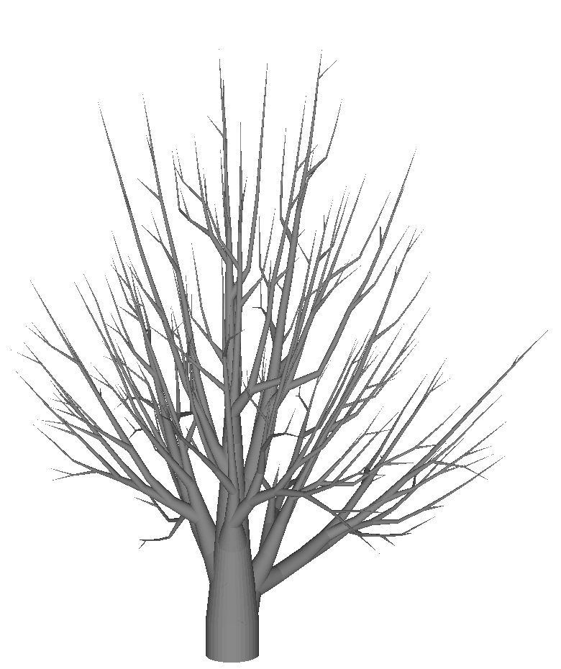
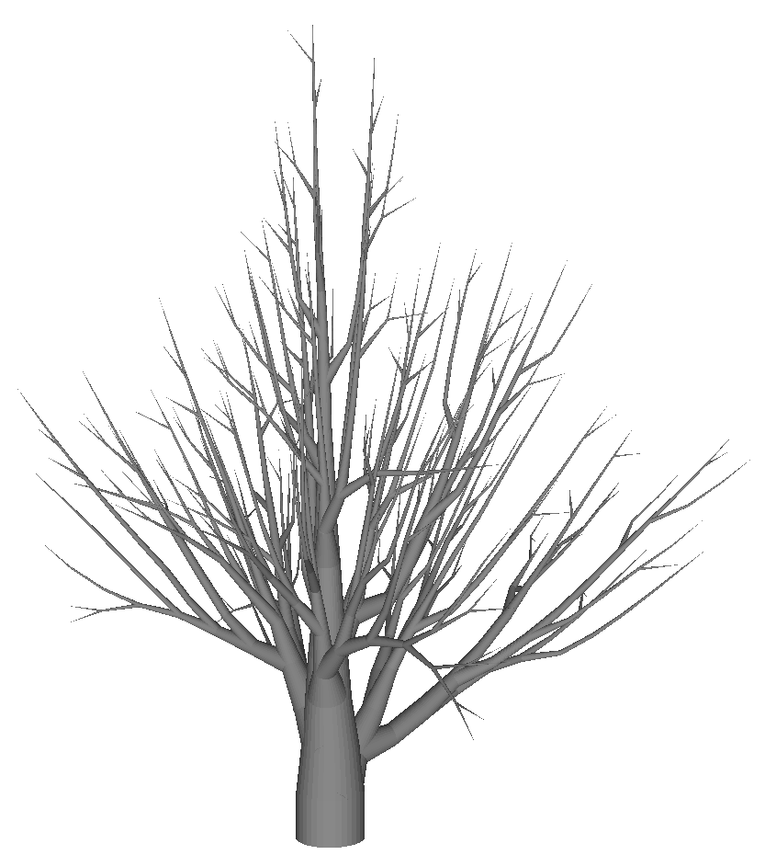
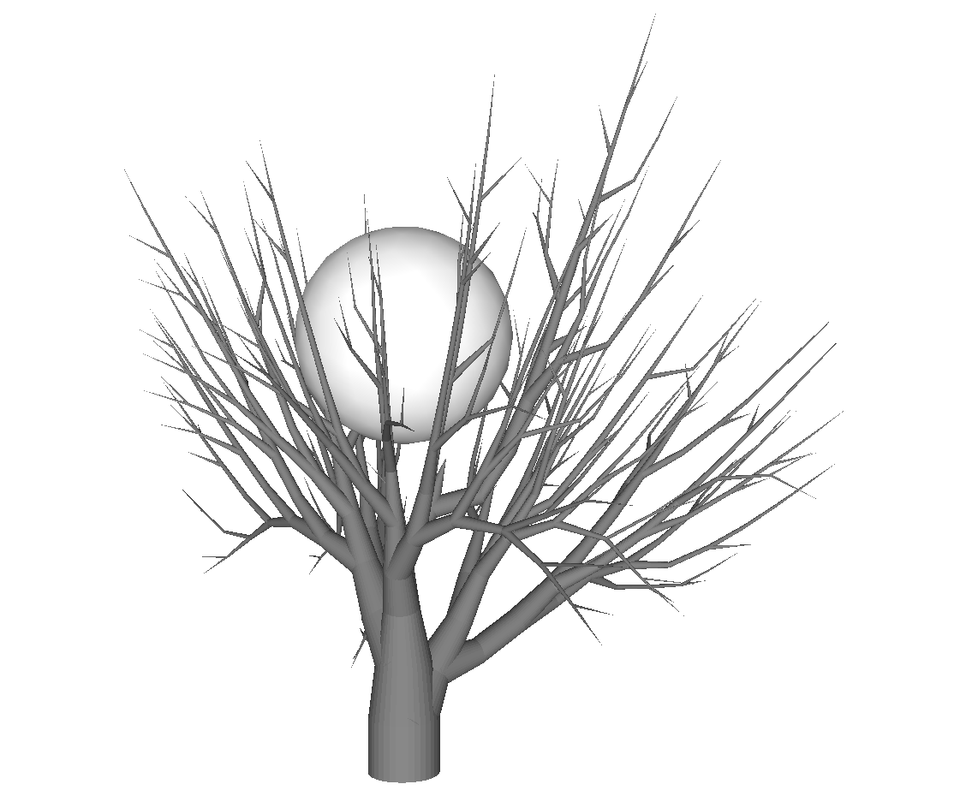
Results
Unique
Obstacle
Notes:
Because my project is to implement a paper
and the paper didn’t specify all the inputs used in each model
I can’t accurately replicate their results.
SO
Tested the reaction to changes in inputs
match the changes shown in the report
And checked the model could replicate the requirements
The images show
All with same inputs
Sphere is an obstacle

Slide 7
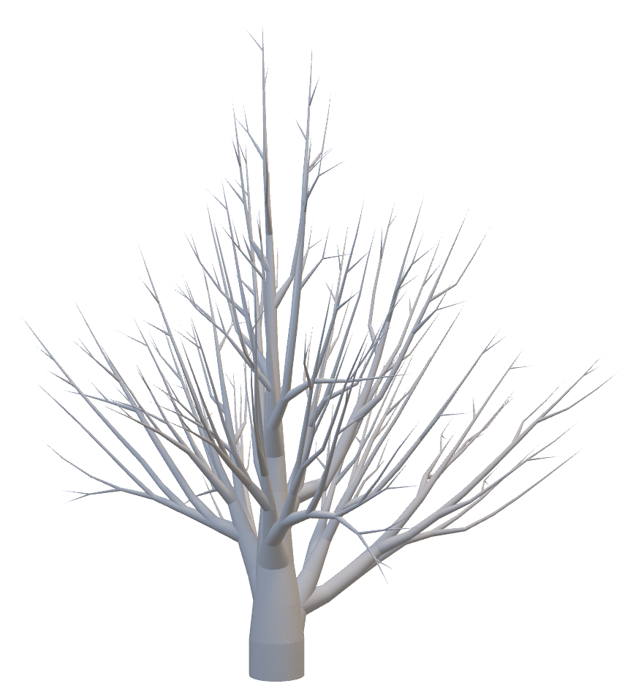
Conclusion
Requirements
Unique
Reacts to Environmental Conditions
Future Work
Implementing Bark Texture
GUI Interface
Notes:
The program I implemented was able to create unique trees which react to environmental conditions
Reactions same/similar to those in paper
Future work:
Bark texture
GUI interface

